Slide 1
WALKING IN THE LIGHT OF ETERNITY
Ephesians 5:6-20

Slide 2
Chronos – Time that can be divided, clock time, managed, not expandible, goes in a spiral circle like a shofar. We are all born into chronos.

Slide 3
Kairos – No English equivalent, closest is ‘eternity breaking into Chronos’ and expanding it so that our lives expand to bear eternity in abundance. We are resurrected into Kairos.

Slide 4
Redeem the Time – Not about getting more done in fewer hours but it is about redemptive actions hence Shaul uses the word ‘walk’ the Hebrew idiom for the way we conduct ourselves in life.

Slide 5
Redeeming the Time = Response Time between Hearing and Obeying
It is coming in alignment with the Father’s will
It is taking hold of Kairos opportunities and acting as Christ would act asap
NOT ABOUT ‘SQUEEZE THE TIME’ BUT ‘SEIZE THE KINGDOM’

Slide 6
REDEEMED TO OBEY
DISOBEDIENT ONES
(Obstinate against the Father’s Will)
Walk as obedient children
We don’t waste Kairos opportunities in the cycles of chronos, we align with the Father’s will and see if our lives are being filled with redemptive pursuits.

Slide 7
REDEEMED TO BEAR FRUIT
DISOBEDIENT ONES
(Obstinate against the Father’s Will)
Walk as obedient children
UNFRUITFUL ONES
(Not bearing Kingdom Fruit)
Walk as fruitful children
Redeem all you can.
Bear fruit:
Awaken from sloth and sin
Learn what pleases the Father
Do whatever is right, good and true as He defines it
No longer associate with unfruitful people and works
Rather ‘expose’ i.e. correct them

Slide 8
REDEEMED TO REDEEM
Make the most of the time
REDEEM IT
As Christ bought us from slavery, we are to buy back God’s purposes from evil days. Time and life are not our own. They are currency we are stewards over.
A PRICE MUST BE PAID FOR REDEMPTION
“We war against the mundane and evil, recapturing and lifting each moment to Him as redemptive worship” Dr Skip Moen
PRICE:
Not being part of the world’s dissecting demands
Not being part of the mad rush and pressures
Giving up a promotion if it demands we give up time with God and family
DISOBEDIENT ONES
(Obstinate against the Father’s Will)
Walk as obedient children
UNFRUITFUL ONES
(Not bearing Kingdom Fruit)
UNWISE ONES
(Cave in to the hardships, pressures, labors, toils, evil around them)
Walk as fruitful children
Walk as wise children

Slide 9
REDEEMED TO REFLECT
Walk as the Father’s children
DISOBEDIENT ONES
(Obstinate against the Father’s Will)
Walk as obedient children
UNFRUITFUL ONES
(Not bearing Kingdom Fruit)
UNWISE ONES
(Cave in to the hardships, pressures, labors, toils, evil around them)
Walk as fruitful children
Walk as wise children
UNREASONABLE ONES
(Morally foolish who act without reason or understanding of God’s will)
Be sensitive to Divine interruptions
Understand the Father’s will and your own obligation to His Kingdom
Be willing to abandon you plans for His
Be willing to be called dreamers, fools and failures because we are a people flowing in sync with the time of another Kingdom.
We must be aligned with God’s time.

Slide 10
The time of God’s wrath is soon approaching when eternity will be ushered into our realm and chronos will cease and all time will be God’s Kairos.

Slide 11
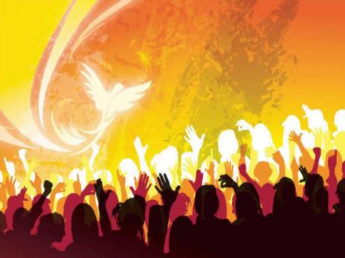
Filled with the Holy Spirit
Join our hands in unity
Raise our lives and moments as worship
Eyes on our Lord – our Master
From whom we were given life and time as gifts and to Whom we stay accountable.

